Slide 1
NSL Sugars Limited, Unit-II, Aland

Slide 2
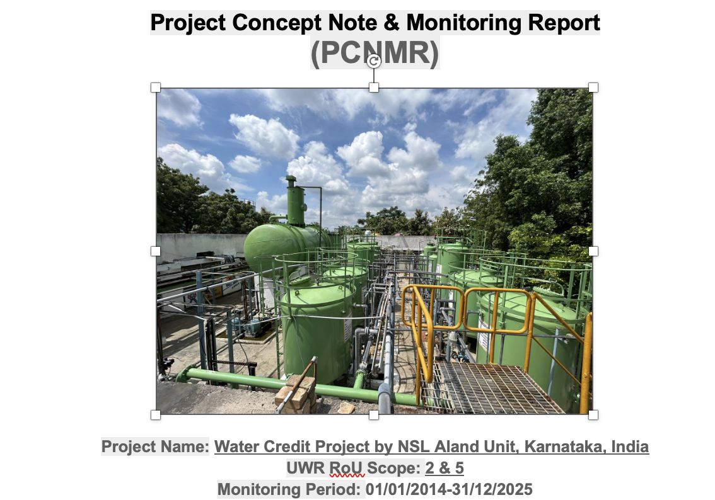


UWR Basic Details

Slide 3
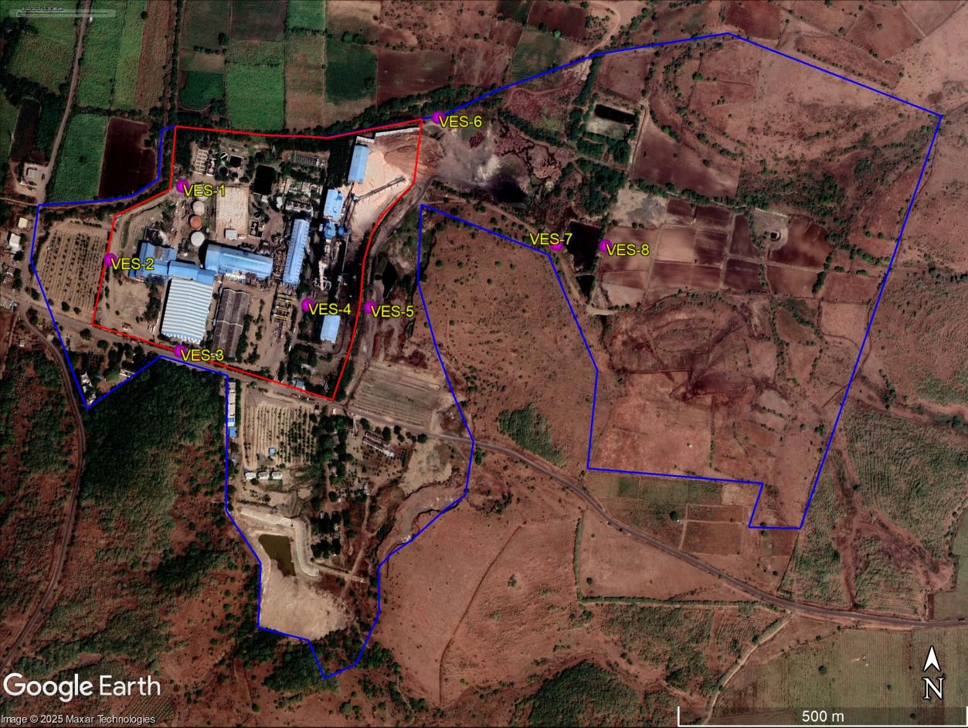
Location of Aland Unit
Picture 1: Location of Aland unit

Slide 4
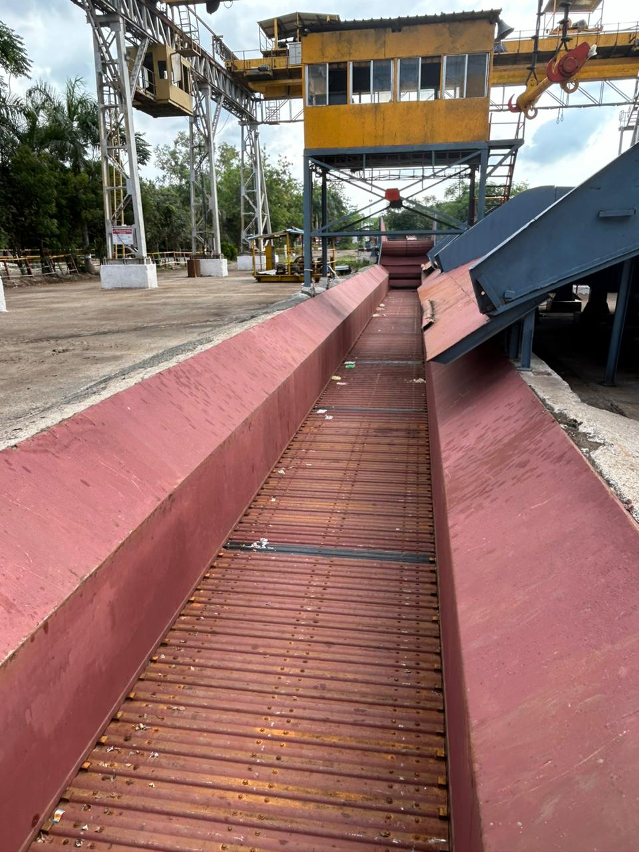
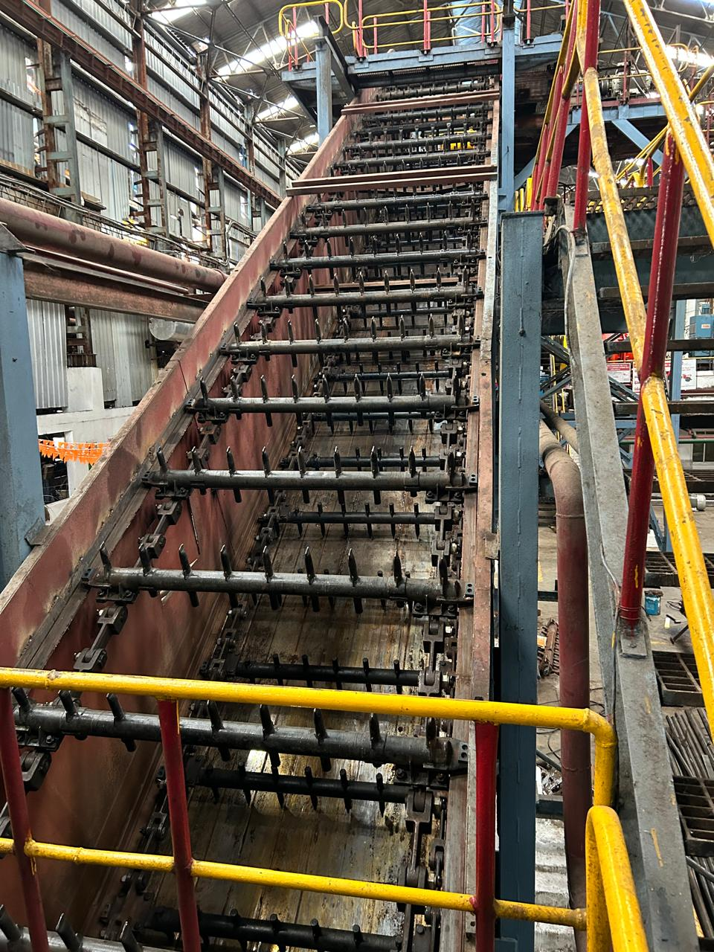
Cane collection section
Picture 2: Cane collection and crushing sections of Aland unit

Slide 5
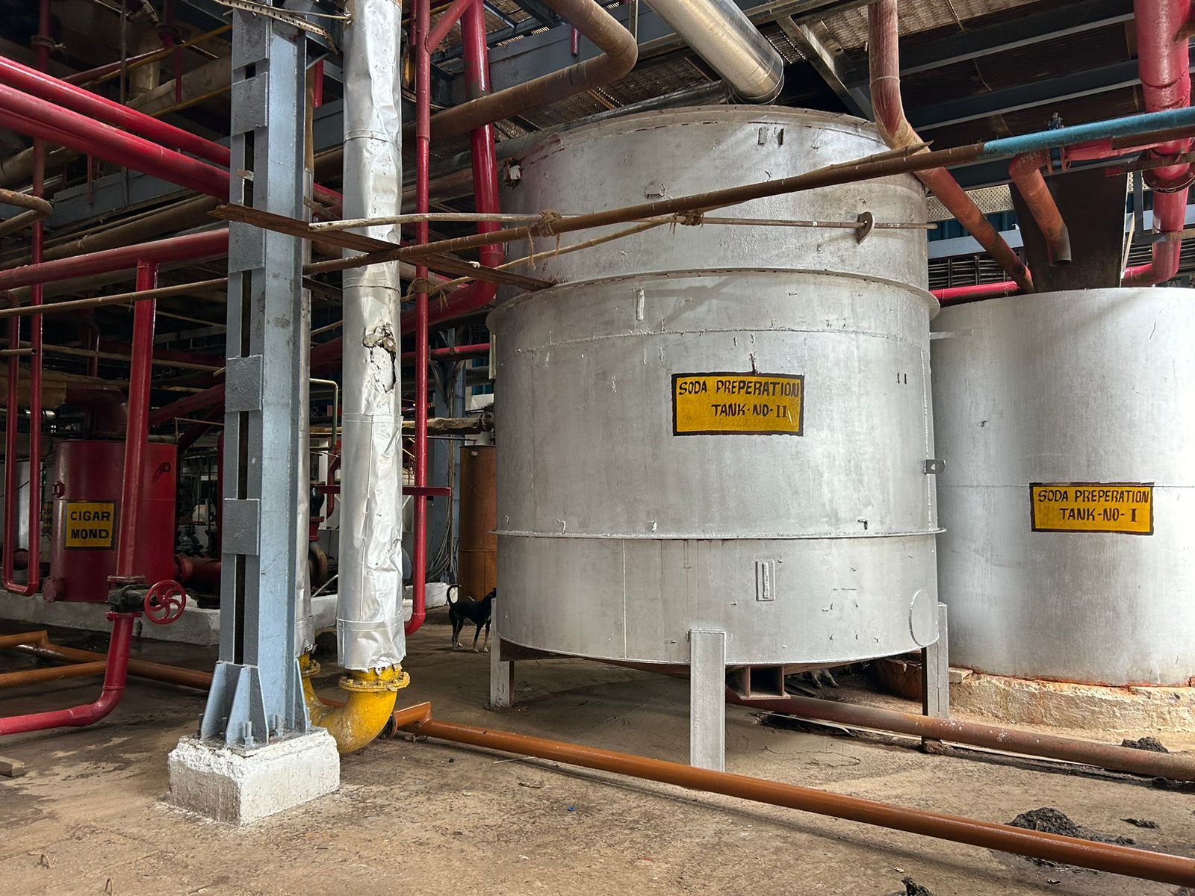
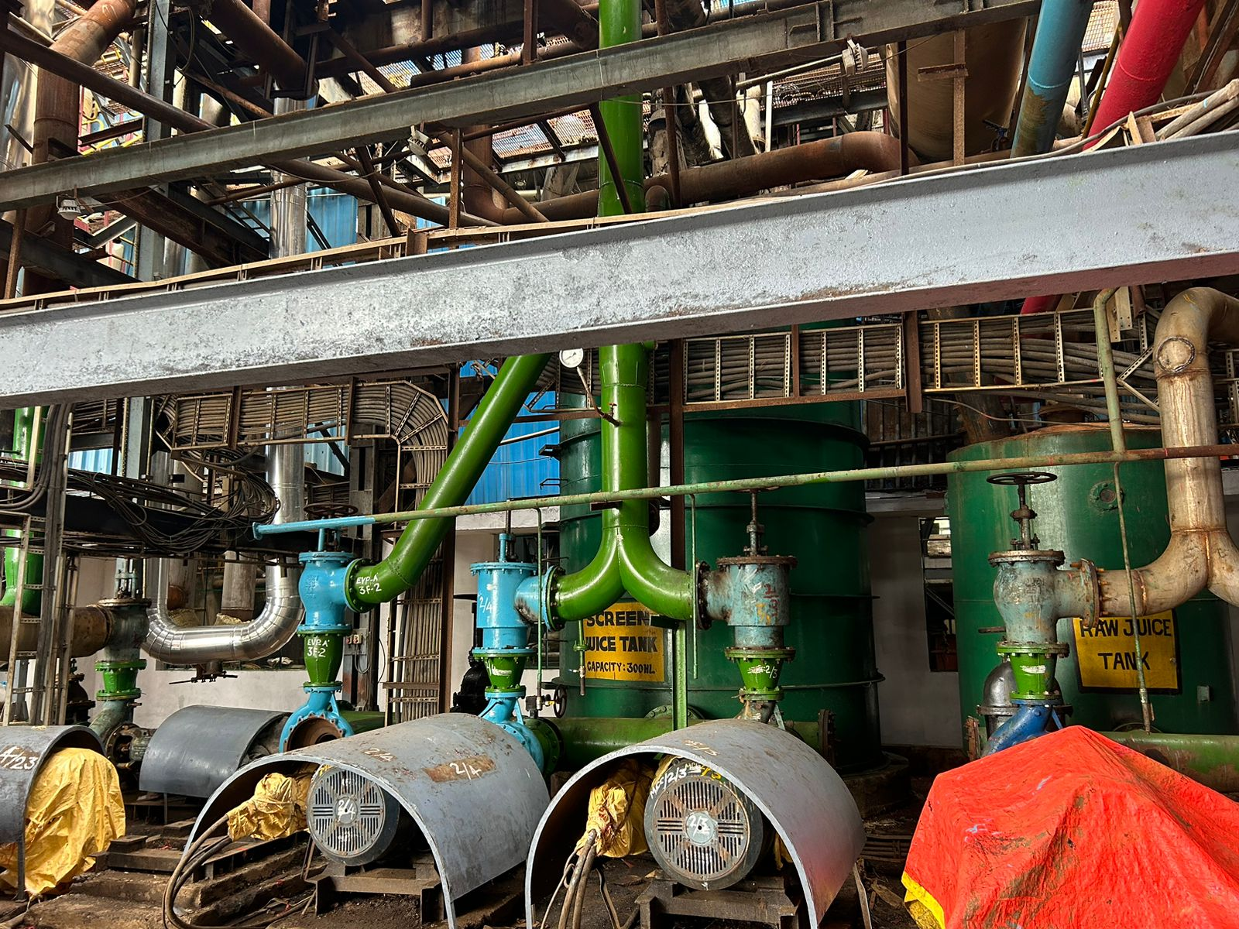
Sugar processing section
Picture 3: Boiling house where impurities are removed from sugarcane juice

Slide 6
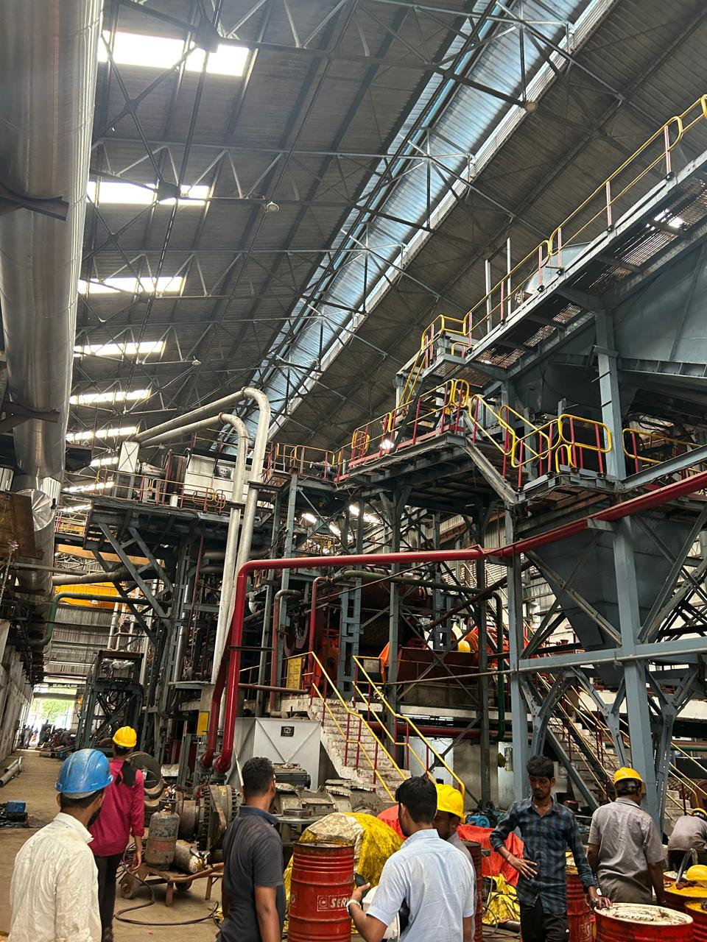
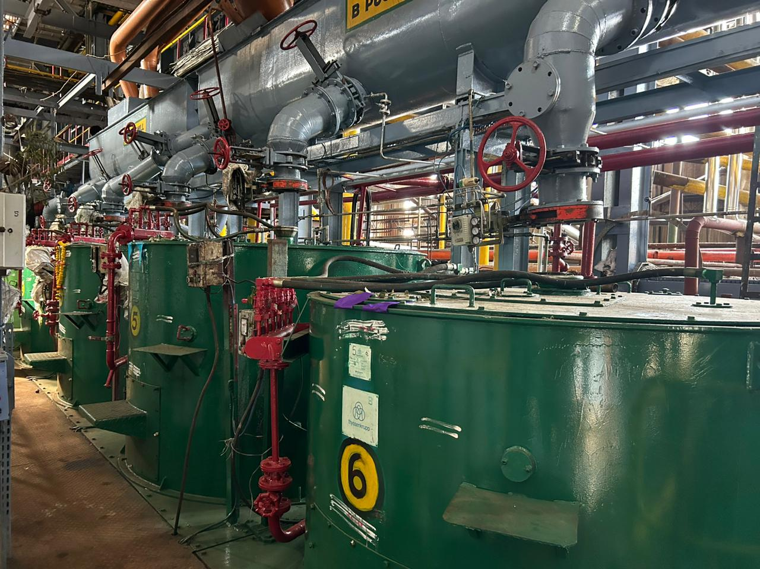
Sugar processing section
Picture 4: (a) Mill house where the cane is crushed to extract juice and (b) Centrifugal section used for separation of sugar crystals from the molasses

Slide 7
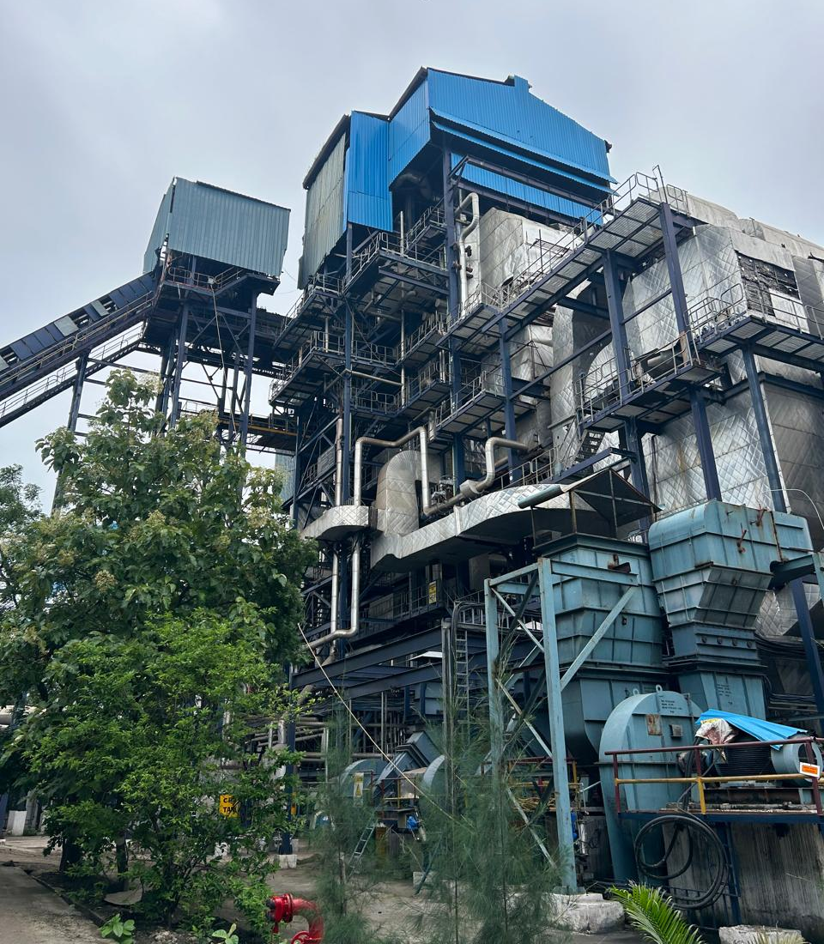
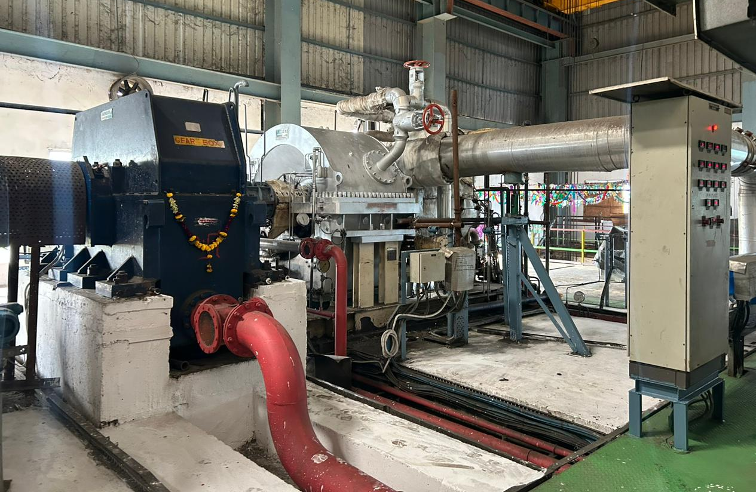
Cogeneration Section
Picture 5: (a) Boiler produce steam that's used in many stages of sugar manufacturing, (b) Turbine section generate electricity and power for the plant‘s uses and export

Slide 8
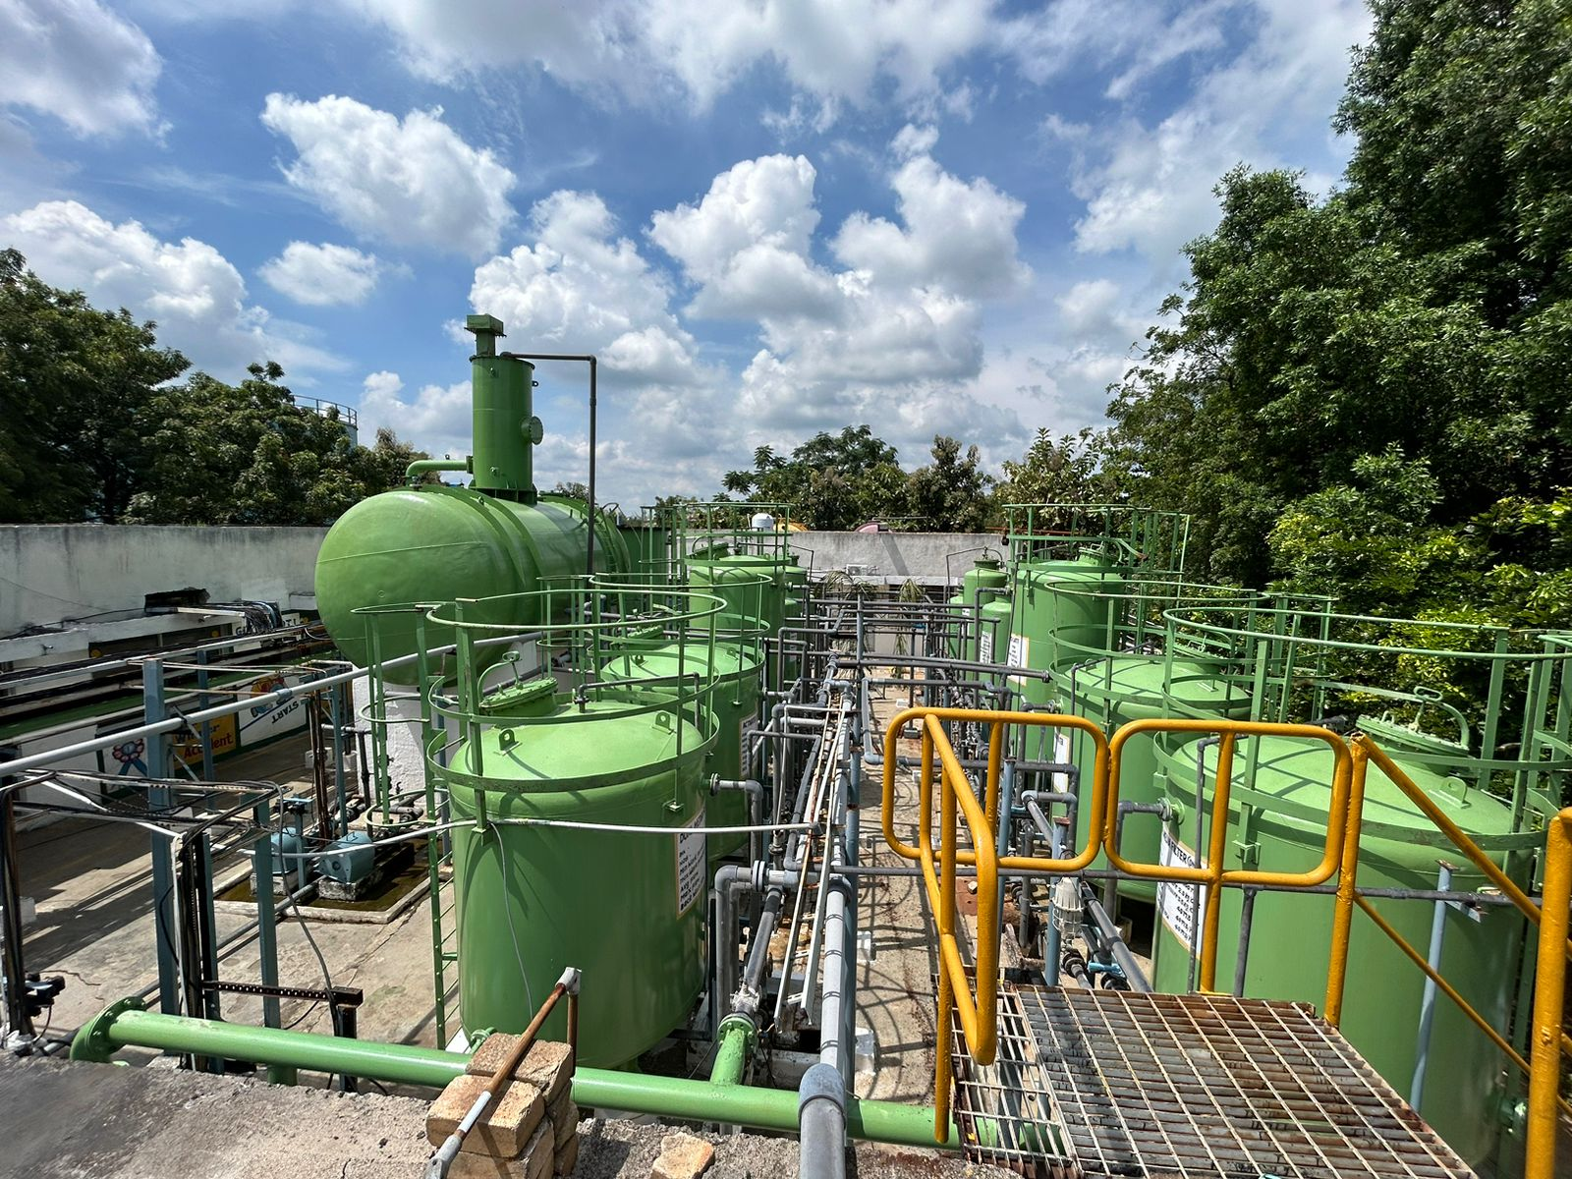
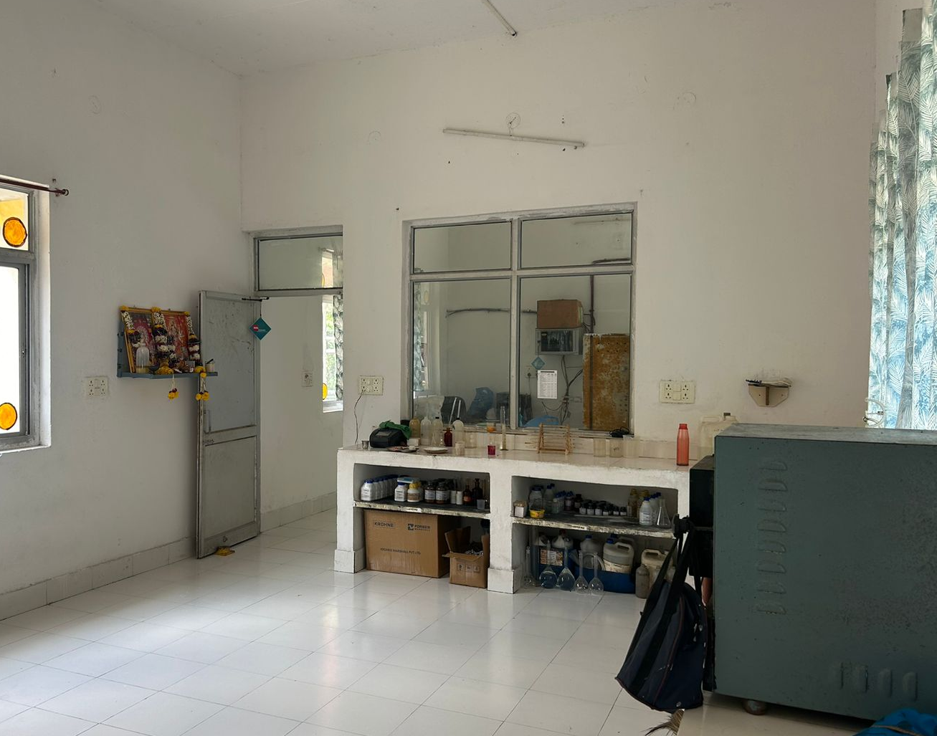
WTP (Water treatment plant)
Picture 6: (a) Water treatment plant capacity of 25 m3/hr and (b) WTP analysis Lab

Slide 9
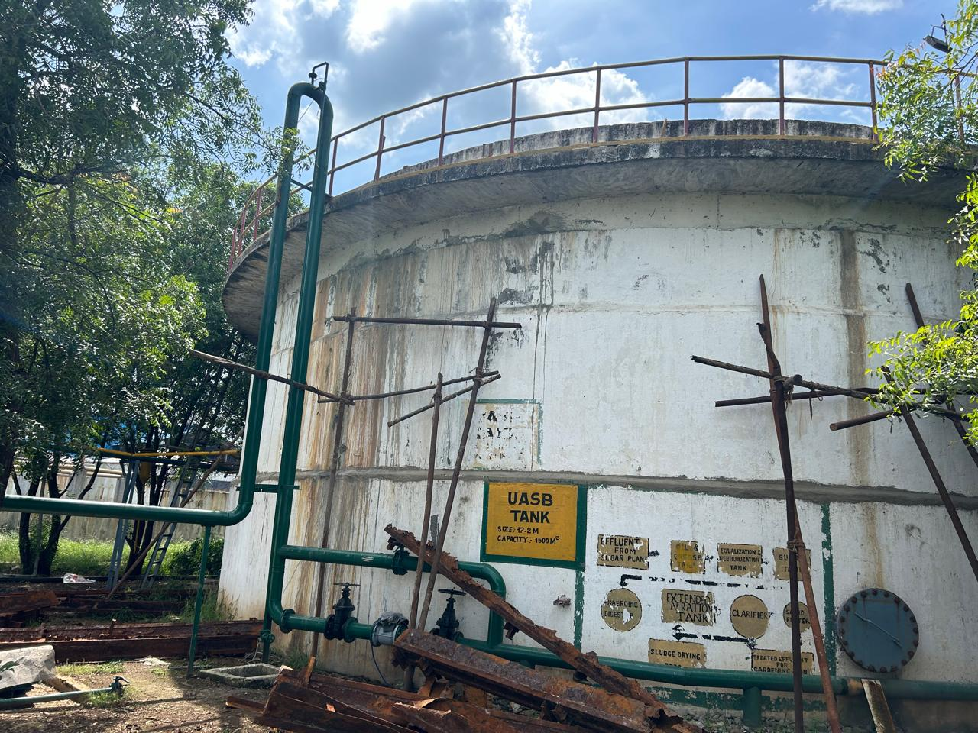
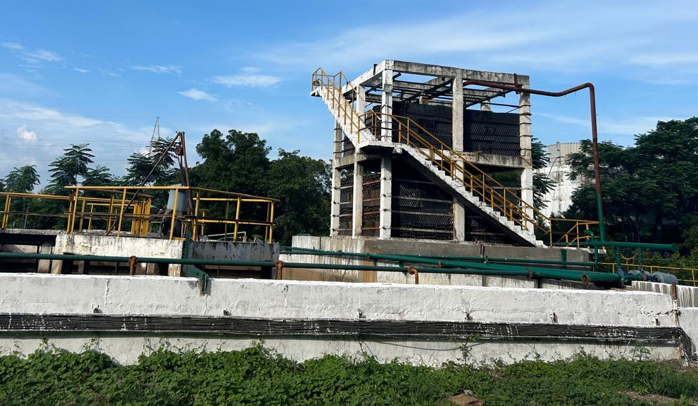
ETP (Effluent treatment plant)
Picture 7: (a) UASB (Anaerobic) Reactor and (b) Aerobic treatment of wastewater

Slide 10
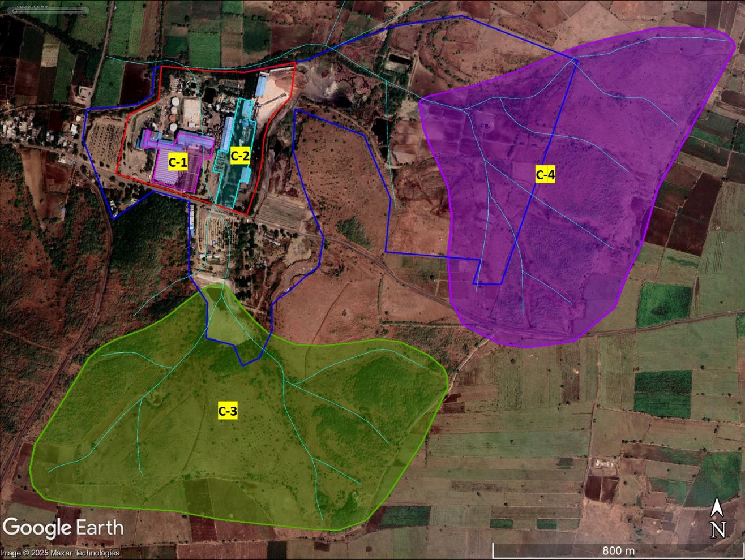
Catchment Areas in Aland Unit
Picture 8: Catchments on google earth, NSL Sugars Aland Unit

Slide 11
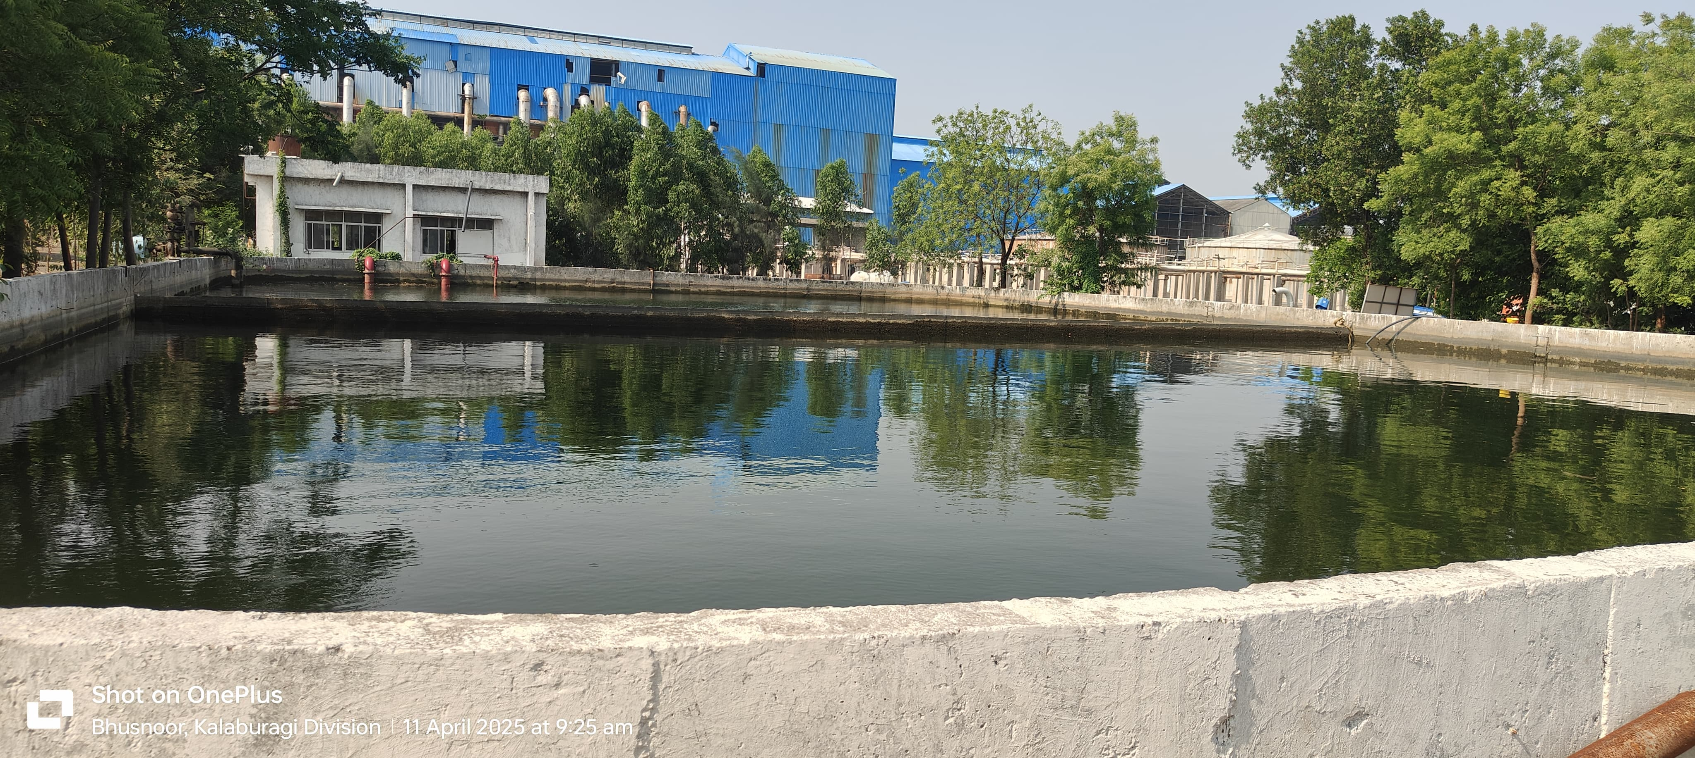
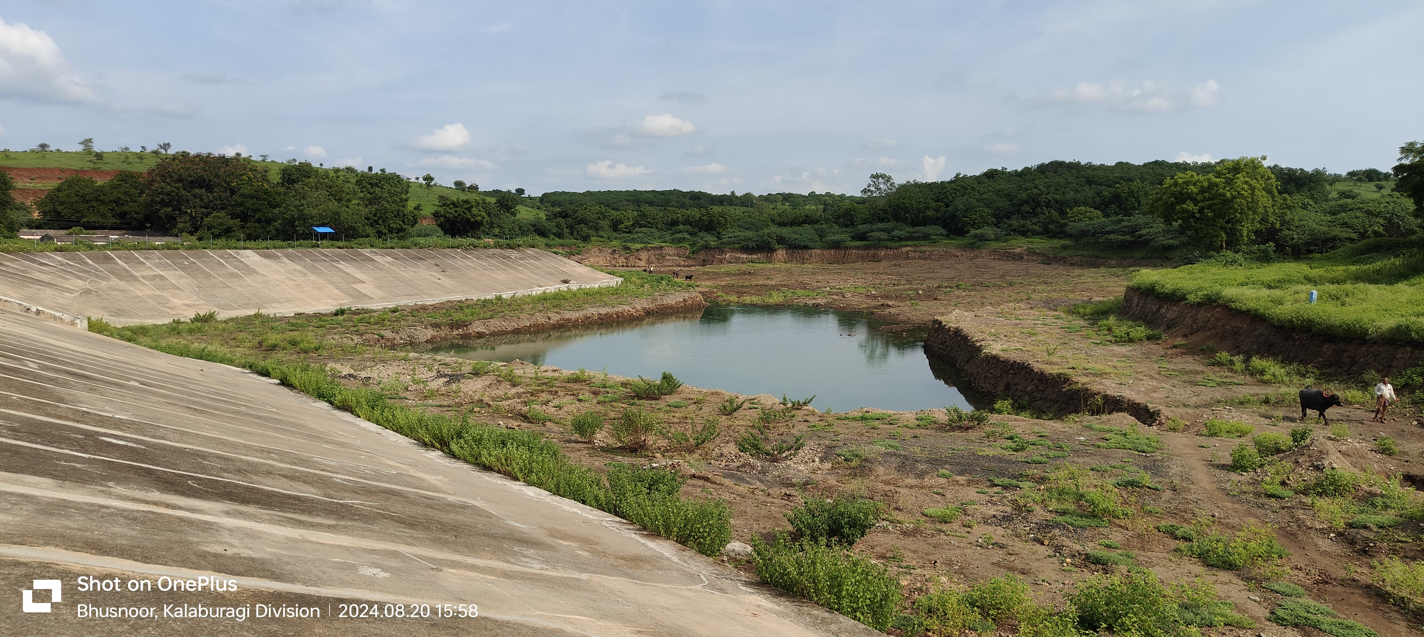
Rainwater Harvesting Unit
Picture 9: (a) A RCC water tank arranged to collect rooftop rainwater and (b) Site image of check dam located in Aland unit premises

Slide 12


